Slide 1


LOAN MANAGEMENT SYSTEM
-
~GROUP K
This Photo by Unknown Author is licensed under CC BY

Slide 2
Agenda
1
2
3
4
5
INTRODUCTION
TO LOAN
MANAGEMENT
KEY CRITERIA
&
TYPES OF
LOANS
FEATURES,CODE
&
COMPARISON
Contribution & challenges to be faced ‘c’ language in loan management system
ADVANTAGES
&
DISADVANTAGES

Slide 3

Introduction
​A Loan Management System is a digital platform which assist lenders in automating and streamlining entire loan life cycle including loan servicing, reporting, customer care, syndication and customer monitoring.
It handles everything from application to repayment, including customer information, propositions, and collections.
A modern loan management system streamlines processes, accelerating the application and decisioning phases of originations by applying automated decision rules.
A loan management system enables lenders to seamlessly manage the loan lifecycle. It centralizes data, enhances communication, and accelerates decision-making, significantly improving operational efficiency. .
This Photo by Unknown Author is licensed under CC BY-SA
This Photo by Unknown Author is licensed under CC BY

Slide 4


KEY CRITERIA FOR LOAN APPROVAL:- Most lenders have similar requirements for personal loans, although the specific qualification standards may vary by lender. For example, two lenders might consider your credit score, but one might require a higher credit score than the other. Here are some other common requirements they might consider: 1) Credit score and history 2) Income 3) Debt-to-income ratio 4) Collateral 5) Origination fee MEETING THESE CRITERIA SIGNIFICANTLY INCREASES THE CHANCES OF THE LOAN APPROVAL & FAVORABE TERMS

Slide 5

Features Of Loan Management
Credit Score:
Loan Amount:
Loan Tenure:
A credit score is a number that depicts a consumer’s creditworthiness. FICO scores range from 300 to 850.
Factors used to calculate your credit score include repayment history, types of loans, length of credit history, debt utilization, and whether you've applied for new accounts.
A credit score plays a key role in a lender’s decision to offer credit and for what terms.
The amount of money you borrow can also affect your interest rate.
Generally, larger loan amounts will have higher interest rates because the risk for the bank is high.
Length of loan term: The length of your loan term can also impact your interest rate.
A loan usually involves an unfixed interest rate that will add additional balance .
A loan tenure, also known as repayment tenure, is the time period between the date of disbursal of your loan amount and the payment date of your last EMI.
For example, if you took out a loan on January 10 2022, and paid your last EMI on January 10 2024, your loan tenure is of 2 years.

Slide 6

FEATURES OF LOAN MANAGEMENT
Income & Employment Status:
Bank account verification:
Typically, lenders prefer applicants who have been employed with the same organisation for two or more years, and earning income consistently.
If you are prone to switching jobs, lenders may consider this behaviour as a red flag, and you may not be deemed eligible for the loan.
Salary slips, bank statements, and ITR are some of the documents required to verify an individual's income and repayment ability. If you are a salaried individual, you will have to provide the last 3 months' salary slips.
Avoiding fraud or getting incorrect payment details should be top of any company’s priority list. So, it’s no surprise that companies like Stripe, Merge, and G2 Deals have been thriving in recent years.
Getting these tools onboard helps you make sure your repayments work exactly as they should—with no surprises along the way.
It confirms that the account belongs to the person or business claiming to own it, and that the details they provided are correct

Slide 7

CODE PRESENTATION: Key Points:- 1} Home Loan. 2}Vehicle Loan. 3}Personal Loan.

Slide 8

HOW ‘C’ LANGUAGE CAN CONTRIBUTE IN EFFECTIVE LOAN MANAGEMENT SYSTEM A loan management system involves various operations such as data storage, retrieval, calculations, and user interactions. C language, while not the most modern choice for developing a complex system like this due to its lower-level nature, can still contribute to an effective loan management system. However, it might have certain limitations compared to more modern languages like Python, Java, or C++, especially in terms of built-in functionalities and ease of development. That said, here's how C language can contribute to an effective loan management system:

Slide 9
How ‘C’ Language Can Contribute In Effective Loan Management System
Performance:
Control Over System Resources:
Mathematical Calculations:
C is a high-performance language that allows for efficient memory management and direct access to system resources. This can be beneficial for handling large amounts of data that a loan management system might deal with, ensuring faster processing times.
C provides low-level control over system resources like memory allocation and deallocation, which can be crucial in optimizing resource usage for a loan management system dealing with extensive data.
C has strong support for mathematical operations, making it suitable for implementing complex loan calculations like interest rates, EMI (Equated Monthly Instalment) calculations, and amortization schedules.

Slide 10
Challenges to be faced by c language in loan management system
Development time:
Complexity & error-proneness:
Lack of modern features:
‘C’ requires more manual effort and detailed programming compared to higher-level languages, which may increase development time.
C lacks modern features found in higher-level languages, making some tasks more cumbersome or requiring additional code.
Due to its low-level nature, C programming requires careful management of memory and pointers. This can lead to more complex code and a higher chance of errors if not handled properly.

Slide 11
TYPES OF LOANS
1
2
3
4
5
Personal
Loan
Home
Loan
Car
Loan
Two -Wheeler
Loan
Education
Loan

Slide 12
PERSONAL LOAN & VEHICLE LOAN
Personal Loan:
Vehicle Loan:
Personal loans are loans that can cover a number of personal expenses.
You can find personal loans through banks, credit unions, and online lenders.
Personal loans can be secured, meaning you need collateral to borrow money, or unsecured, with no collateral needed.
Personal loans can vary greatly when it comes to their interest rates, fees, amounts, and repayment terms.
A Vehicle Loan is a loan that allows you to purchase two and four wheelers for personal use.
Typically, the lender loans the money (making a direct payment to the dealer on the buyer's behalf) while the buyer must repay the loan in Equated Monthly Instalments (EMIs) over a specific tenure at a specific interest rate.
Vehicle Loan means the secured loan provided to you under the Secured Credit Agreement for the primary purpose of financing the purchase of the Financed Vehicle

Slide 13
HOME LOAN & EDUCATION LOAN
Home Loan:
Education Loan:
A home loan is a secured loan that is obtained to purchase a property by offering it as collateral.
Home loans offer high-value funding at economical interest rates and for long tenures.
They are repaid through EMIs.
This is the most common type of home loan.
As the name suggests, these loans are meant for buying a new apartment, row house, or bungalow, from a developer or a development authority. You can use this type of loan to purchase under-construction or ready properties.
An education loan is a sum of money borrowed to finance post-secondary education or higher education-related expenses.
Education loans are intended to cover the cost of tuition, books and supplies, and living expenses while the borrower is in the process of pursuing a degree.
Payments are often deferred while students are in college and, depending on the lender, sometimes they are deferred for an additional six-month period after earning a degree.

Slide 14
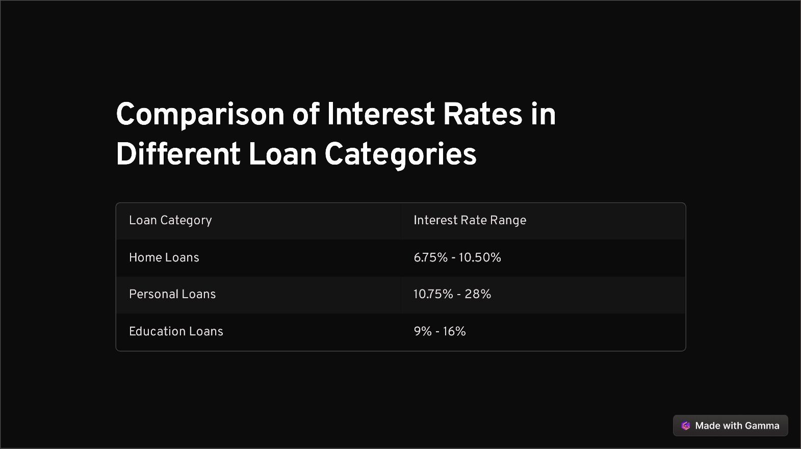
COMPARISON OF INTEREST RATES IN DIFFERENT CATEGORIES

Slide 15
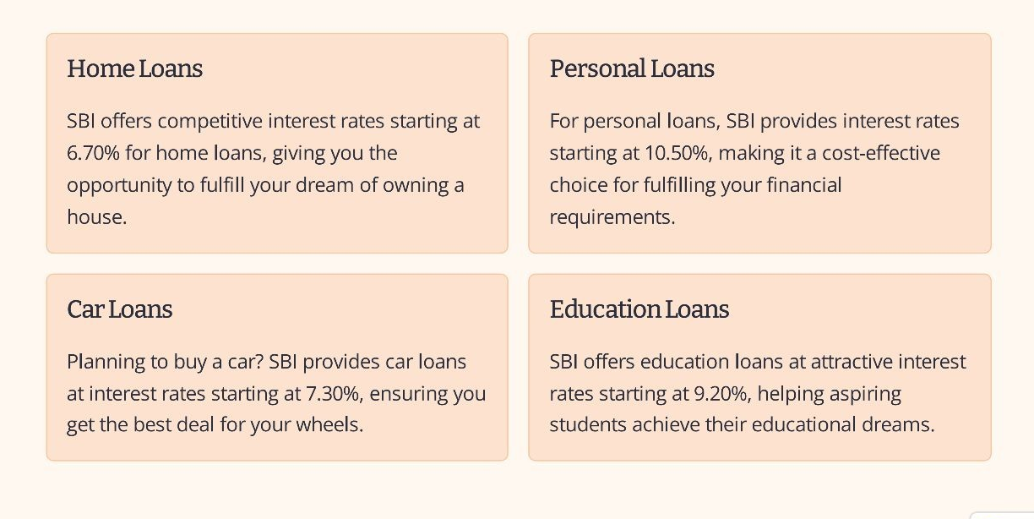
OVERVIEW OF SBI LOAN INTEREST RATES

Slide 16
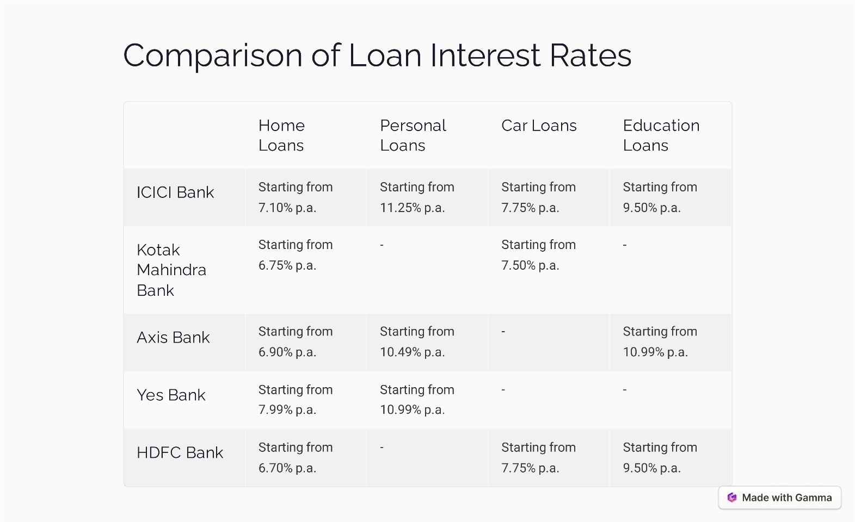
COMPARISON OF INTEREST RATES B/W SOME SOUNDED PRIVATE BANKS

Slide 17
ADVANTAGES OF TAKING A LOAN
Opportunity for growth:
Financial Stability:
Building Credit:
A loan provides you with the flexibility to meet your financial goals or handle unexpected expenses without depleting your savings.
By accessing funds through a loan, you can invest in education, a business, or real estate, opening doors to new opportunities.
Successfully managing a loan helps establish a positive credit history, which can lead to lower interest rates in future.

Slide 18
DISADVANTAGES IF TAKING A LOAN
Lengthy application process:
Strict eligibility criteria:
Not suitable for ongoing expenses:
Preparing for a business loan application can also be a long and time-consuming process. Not only will you need to fill out an application form for each lender, but you will also need to provide a business plan, your account history, and your financial forecasts to show your business is a viable lending prospect.
One of the major disadvantages of a bank loan is that banks can be cautious about lending to small businesses. Their strict lending criteria can make it particularly difficult for start-ups and newer businesses to be accepted for a loan.
One of the other disadvantages of a bank loan is that you can only use the funds for certain projects or purposes that will help grow your business, and not usually to cover any ongoing expenses. Banks will want to lend to businesses that will be able to repay the money.

Slide 19
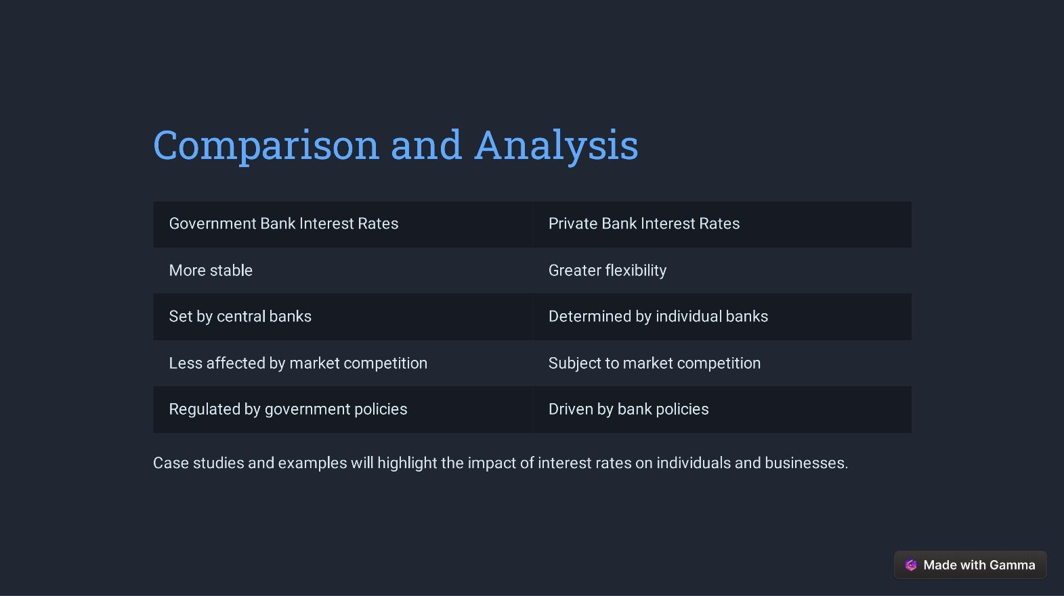
Comparison Analysis

Slide 20
CONCLUSION
Summary:
Choosing A Bank:
Final Remarks:
Government bank interest rates offer stability, while private bank rates provide flexibility and customization.
Consider the importance of interest rates, personal financial goals, and preferred level of service when selecting between banks.
Making informed decisions about interest rates can contribute to financial well-being and long term financial success.

Slide 21
THANKYOU FOR BEING A PATIENT LISTENER.
“
”
~GROUP K

Slide 22
GROUP MEMBERS
NIKHIL
KHANTWAL
SURAJ
SINGH
NEGI
ABSENT
SANJANA
SINGH
VEDANSH TYAGI

Slide 23

Thank you
~GROUP K
This Photo by Unknown Author is licensed under CC BY-NC

